Slide 1


CONTROL SYSTEM PROJECT
TEAM 3
MULTI-COMMAND ROBOT
CAR

Slide 2


PROBLEM STATEMENT :
To learn the basics of controlling a robot by different methods of operation,
TEAM MEMBERS | SRN
YASH KANKARIA | PES1UG20EE076
VIJAY KUMAR | PES1UG20EE073
B SAI SOUMITH | PES1UG20EE081

Slide 3
DESCRIPTION :
We will learn how to make a multi-functional robot using the Arduino platform. That is, this includes obstacle avoidance, Bluetooth control, and voice control functions. Also, It mainly uses an Ultrasonic sensor and a Bluetooth module. The L293D motor drive shield is used to drive the motors

Slide 4
COMPONENTS REQUIRED:
.Arduino Uno x 1.
Gear motor x 4.
Motor Driver(L293D) x1.
Ultrasonic sensor x 1
Bluetooth module x 1
Li-ion battery

Slide 5
Overview :
1.Obstacle avoidance
In this case, the robot car moves along using the obstacle avoiding. The ultrasonic sensor is mainly used for this purpose.
2.Bluetooth control
In this case, we can control the robot through an app on the smartphone. The Bluetooth module is used for this.
3.Voice control
In this case, we can control this robot using several voice commands. This also requires a Bluetooth module and mobile app.

Slide 6
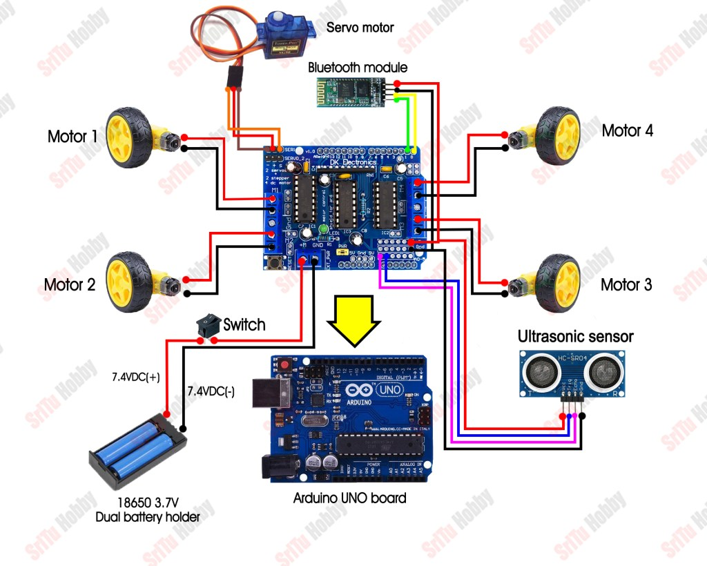
Circuit diagram:

Slide 7
Working procedure :
Once this robot car is activated, a slight delay begins to activate. The first time the ultrasonic sensor is shaking slightly. That way we can see that the robot is active. It also increases the robot’s attractiveness.
Afterward, the ultrasonic sensor is activated.
At the same time, the four motors begin to rotate forward. That’s how the robot car starts to move forward.
Going forward, when the sensor value is less than 30 cm, the four motors stop and rotate backward for half a second.

Slide 8
Later, this robot car stops. The sensor is then rotated left and right to calculate the distance. For that uses a servo motor.
Next, this servo motor stops at the starting point. Then, using the distance obtained by looking left and right, the robot car turns to the long-distance and goes forward. To turn the car, the motors must rotate backward on one side and the motors rotate forward on the other side.

Slide 9
BASIC APPLICATIONS :
SMALL SCALE TRANSPORTATION IN INDUSTRIES
. Smart Parking System based on Ultrasonic Sensor
. Obstacle avoiding robots can be used in almost all mobile robot navigation systems.
They can also be used in dangerous environments, where human penetration could be fatal.

Slide 10
THANK YOU

